Slide 1

Tracking user details from an insecure website using HTTP
Section: B
GROUP NO. : 8
GUIDE : Dr. PRAMOD M S
GROUP MEMBERS:
Name (SRN) Nikshitha SV(PES2UG19EC087)
Name (SRN) Mansoora S(PES2UG19EC070)
Name (SRN) Nikhita Sridhar (PES2UG19EC086)

Slide 2
INTRODUCTION
Internet users must check whether a website with different interfaces is safe enough to enter their personal information. While web browsing, users use many new websites or seemingly safe and familiar ones. Mistyped URLs or search engine links can direct users to potentially malicious websites. Modern web browsers provide security indicators to prevent this, but the technical details of these indicators are understood only by a few users. Therefore, the user’s knowledge about logging into a website which may be secure or insecure is very essential.

Slide 3
PROBLEM STATEMENT
Tracking the user details from an insecure website using HTTP in Wireshark
This can be done using the filter ‘HTTP’ in Wireshark.
Wireshark is an opensource packet analyzer, its main objective is analyzing traffic and communications and resolving network problems.

Slide 4
LITERATURE SURVEY
Sno. | Paper Details | Description | Drawbacks | Enhancements
1 | Mohammed, Degodzor and Effrin “Brute force attack detection and inter prevention on a network using Wireshark.” | Brute force attack is a method used to detect login credentials using random combination of username and passwords, It is a simple tactic used by hackers to gain unauthorised access to individual accounts or any organisation. | Using this technique its is very easy for the hackers to track the user name and passwords of the users easily. So it is necessary for the user to protect their details from such attacks | Security awareness: It is necessary for the user to have security awareness to realise that their sensitive information like their username and password are at a high risk when neglected, and are prone to fall for such attacks.
2 | Timothy Kelley, Bennet I Bertenthal “Real world decision making logging into secure vs insecure websites.” | An experiment conducted by experts to login to different secure and insecure websites and decide whether or not it was safe to login. Hierarchical linear regression models were used to identify the importance of the presence of security indicators and security domain knowledge | Limited no. of participants and ability to interact with the website to collect additional clues about potential risks. Firefox was the only browser that was permitted for this experiment which limited users to explore other browsers | This experiment can be updated by updating the web browser used and collecting more login attempts

Slide 5
3. | Nayak, Mr. Parikshith, S. H. Brahmananda, and Mrs. Sahana DS. "An Approach to Sniff Sensitive Information by Packet Sniffing." | This paper talks about reviewing some of the problems from a diverse range of internet backgrounds, It is found that http protocol is excessively used in Nepal’s internet space for transferring web credentials (Shodan, 2019) and that majority of end users do not know basic concepts about ssl and encryption. Using a traditional tool like Wireshark, we were able to extract the user details very easily from a basic site that uses HTTP. | According to Nepal telecommunication authority, Nepal’s internet penetration rate is 63% as of 2018. With this increasing number, the responsibility of network monitoring has increased for network and security professionals. | It is quite difficult to filter if the sniffers are operated for a long time to get secret confidential values. Hence, packet sniffer to sniff secret credentials can be a handy tool for network and security professionals either for troubleshooting or penetration testing purpose.

Slide 6
OBJECTIVE
The main objective of this project is to create awareness among users about tracking of user details from an insecure website under HTTP using Wireshark.

Slide 7
METHODOLOGY
Tracking user details can be done using the Wireshark filter ‘HTTP’. Adding this in the Wireshark filter window filters out only the HTTP packets. Further, to get the exact packets with the login details, modifying the filter to ‘http.request.method==”POST” ’, gives only the packets with that contain login details as the HTTP protocol uses POST method.
HTTP ‘POST’ method is used to send data from the client to the server. This method requests the server to accept the data enclosed in the post message. POST method is generally used while submitting login details or while uploading files and images to the web server.

Slide 8
Software Requirements:
Wireshark
Web browser where the server is running

Slide 9
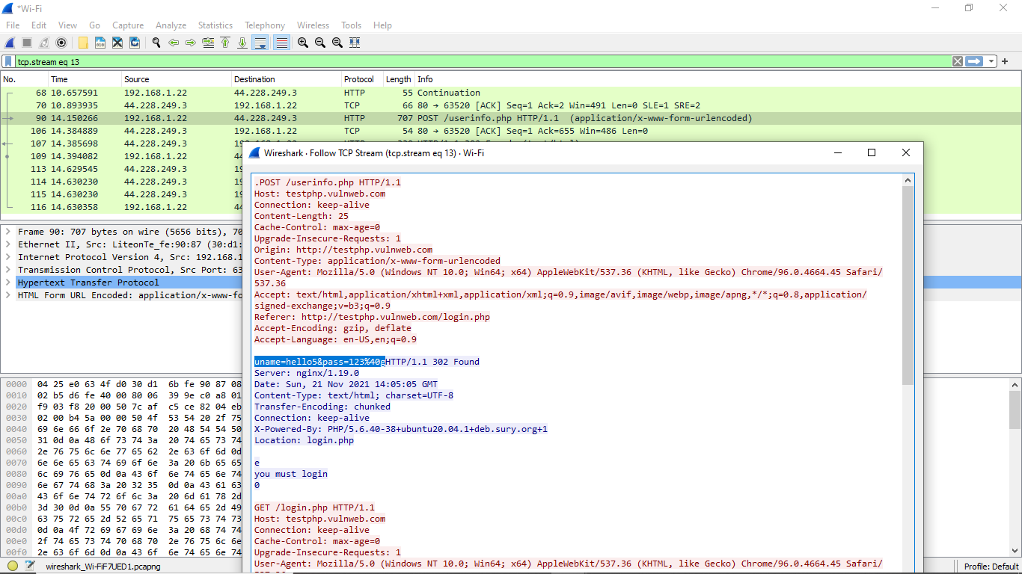
Results
When the analysis is run, the username and password entered in an insecure website such as HTTP://testphp.vulnweb.com/login.php which uses the HTTP protocol, is retrieved very easily as shown below.

Slide 10
Conclusion
Today, the world is gravitating towards a technology dependent lifestyle. Without understanding the security features of a website, a user may become a victim of cyber-crime. By entering personal details and/or login credentials into an insecure website, a 3rd person can easily retrieve the data as demonstrated in the project. Many software like Wireshark is used to analyze data and communication from hosts to clients. However, when used for malicious reasons, can result in loss or illegal extraction of data. Thus, ensure that any classified information is sent from one host to another only as encoded data. This project acts as a demonstration to show how susceptible your information can be to such malpractice and to give a clearer understanding of the protocols HTTP and HTTPS.

Slide 11
REFERENCES
1. Mustapha Adamu Mohammed, Ashigbi Franin Degodzor, Bothey Francis Effrin
“Brute force attack detection and inter prevention on a network using Wireshark.”
http://www.ijesrt.com/issues%20pdf%20file/Archive-2017/June-2017/4.pdf
2. Timothy Kelley, Bennet I Bertenthal
“Real world decision making logging into secure vs insecure websites.”
https://www.ndss-symposium.org/wp-content/uploads/2017/09/real-world-decision-making-logging-into-secure-vs-insecure-websites.pdf
3. Nayak, Mr. Parikshith, S. H. Brahmananda, and Mrs. Sahana DS.
"An Approach to Sniff Sensitive Information by Packet Sniffing."
https://www.xajzkjdx.cn/gallery/161-april2020.pdf

Slide 12
QUERIES ?

Slide 13
Project Demo Video
Google Drive link of Demo video
https://drive.google.com/file/d/1lrofa_jlI1cAdcpYBhODveHIXa2kwKE/view?usp=drivesdk

Slide 14
THANK YOU

